Slide 1
FRAUD DETECTION USING TRANSACTION DATASET
PRESENTED BY NEHA

Slide 2
Project Overview
Objective: Build a machine learning model to detect fraudulent transactions.
Approach: Use LightGBM (Gradient Boosting Framework)
Key Goals:
High recall for frauds
Low false positives
Explainable model

Slide 3
Dataset Summary
Features Used:
TX_DATETIME: Timestamp
CUSTOMER_ID, TERMINAL_ID
TX_AMOUNT, TX_FRAUD (Target)
Volume:
Total transactions: 350,843
Fraudulent transactions: 2,936 (0.8%)

Slide 4
Preprocessing Steps
Converted TX_DATETIME to datetime format
Sorted transactions by customer & timestamp
Filled missing values with zero

Slide 5
Feature Engineering
Customer Transaction Count (7 days)
Rolling count of transactions per customer
Terminal Fraud Ratio (7 days)
Rolling mean of frauds per terminal
Transaction Hour
Extracted from timestamp

Slide 6
1.Rolling Transaction Count (Last 7 Days)
What? For each customer, we count how many transactions they made in the past 7 days before each transaction.
Why? Helps detect unusual spikes in customer activity which may indicate a fraudster is using stolen credentials.
How? Using .rolling('7D') on TX_DATETIME within each CUSTOMER_ID group.
Feature Created: customer_tx_count_7d
📌 Example: If a customer usually makes 1 tx/day and suddenly does 5/day, this feature captures that spike.

Slide 7
2. Terminal Risk Feature:
Rolling Fraud Ratio (Last 7 Days)
What? For each merchant terminal, we compute the proportion of fraudulent transactions in the past 7 days.
Why? Terminals that are recently compromised (e.g., through phishing) show a spike in fraud rate.
How? Using .rolling('7D') on TX_DATETIME within each TERMINAL_ID group:
fraud_tx = sum of TX_FRAUD
total_tx = count of TX_FRAUD
fraud_ratio = fraud_tx / total_tx
Feature Created: terminal_fraud_ratio_7d
📌 If a terminal usually sees no fraud but suddenly has a 30% fraud rate, this feature highlights it.

Slide 8
🔧 Technical Implementation
Used groupby + rolling() + time-based windowing ('7D')
Handled time series by setting TX_DATETIME as index temporarily
Reset index after feature creation to keep structure intact

Slide 9
Model Training
Model: LightGBM Classifier
Objective: Binary classification (fraud vs non-fraud)
Evaluation Metric: AUC
Train-Test Split: 70-30
Handling Imbalance:
Used scale_pos_weight=10

Slide 10
Model Performance
ROC AUC Score: 0.998
Classification Report:
Precision (Fraud): 0.33
Recall (Fraud): 0.98
F1-Score (Fraud): 0.50
Insight: Model captures most frauds but with many false positives

Slide 11
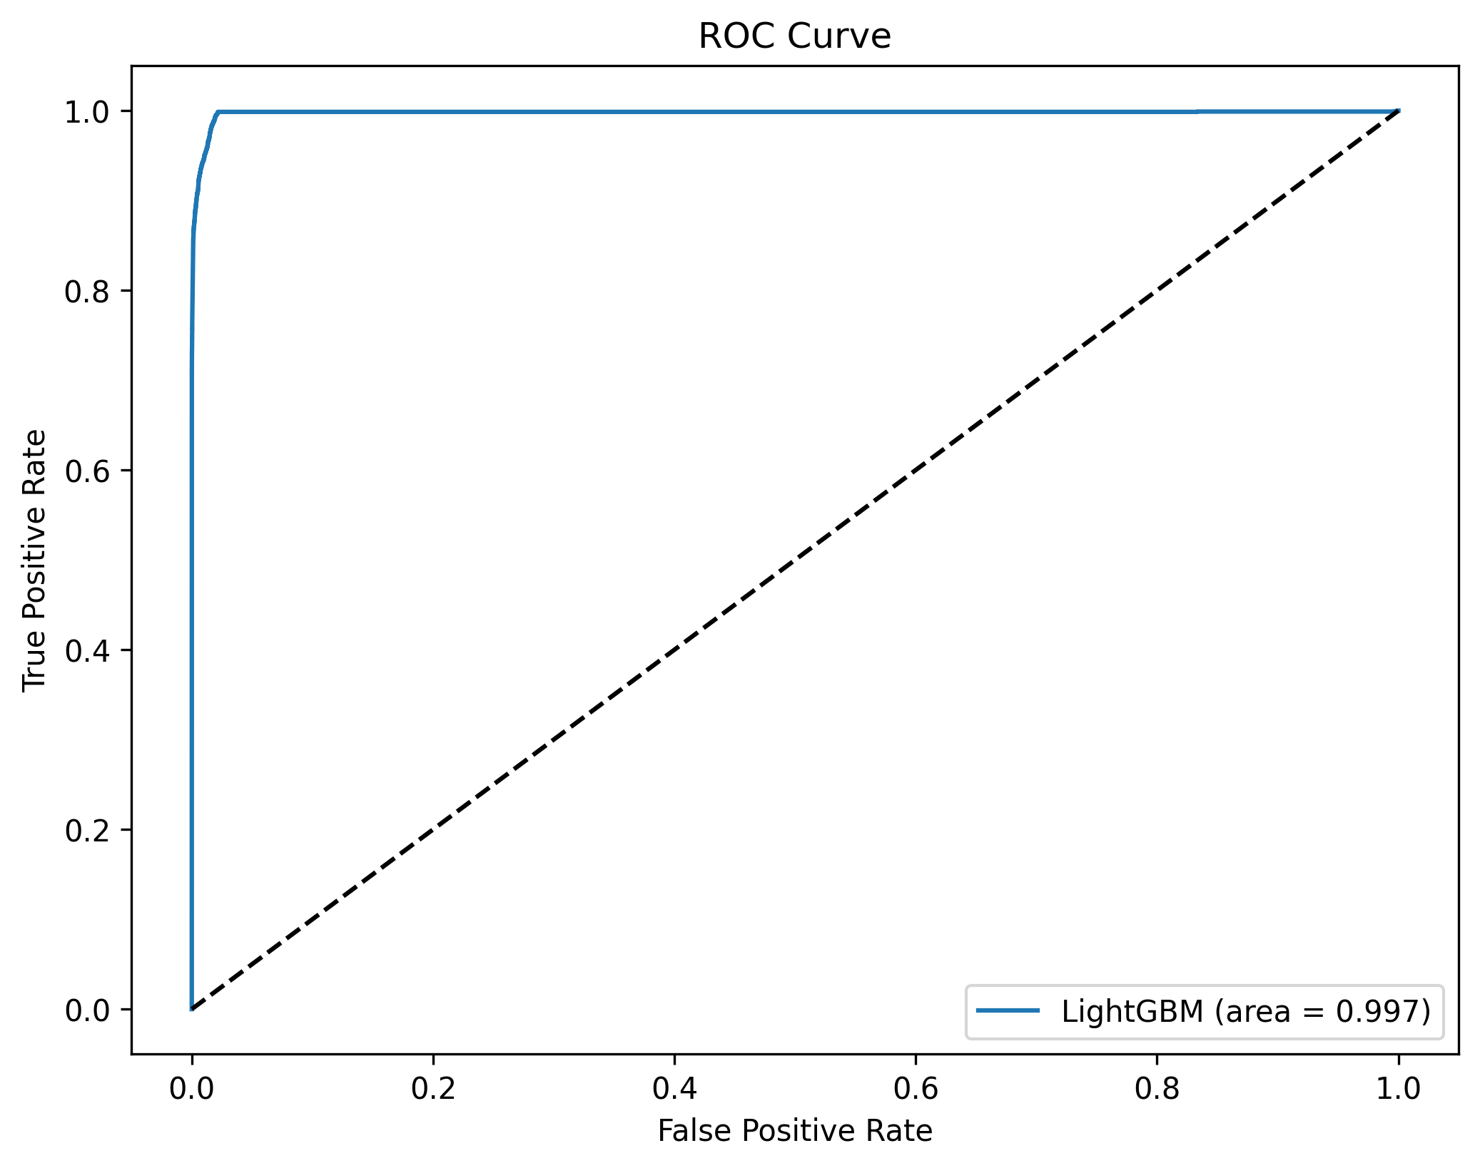
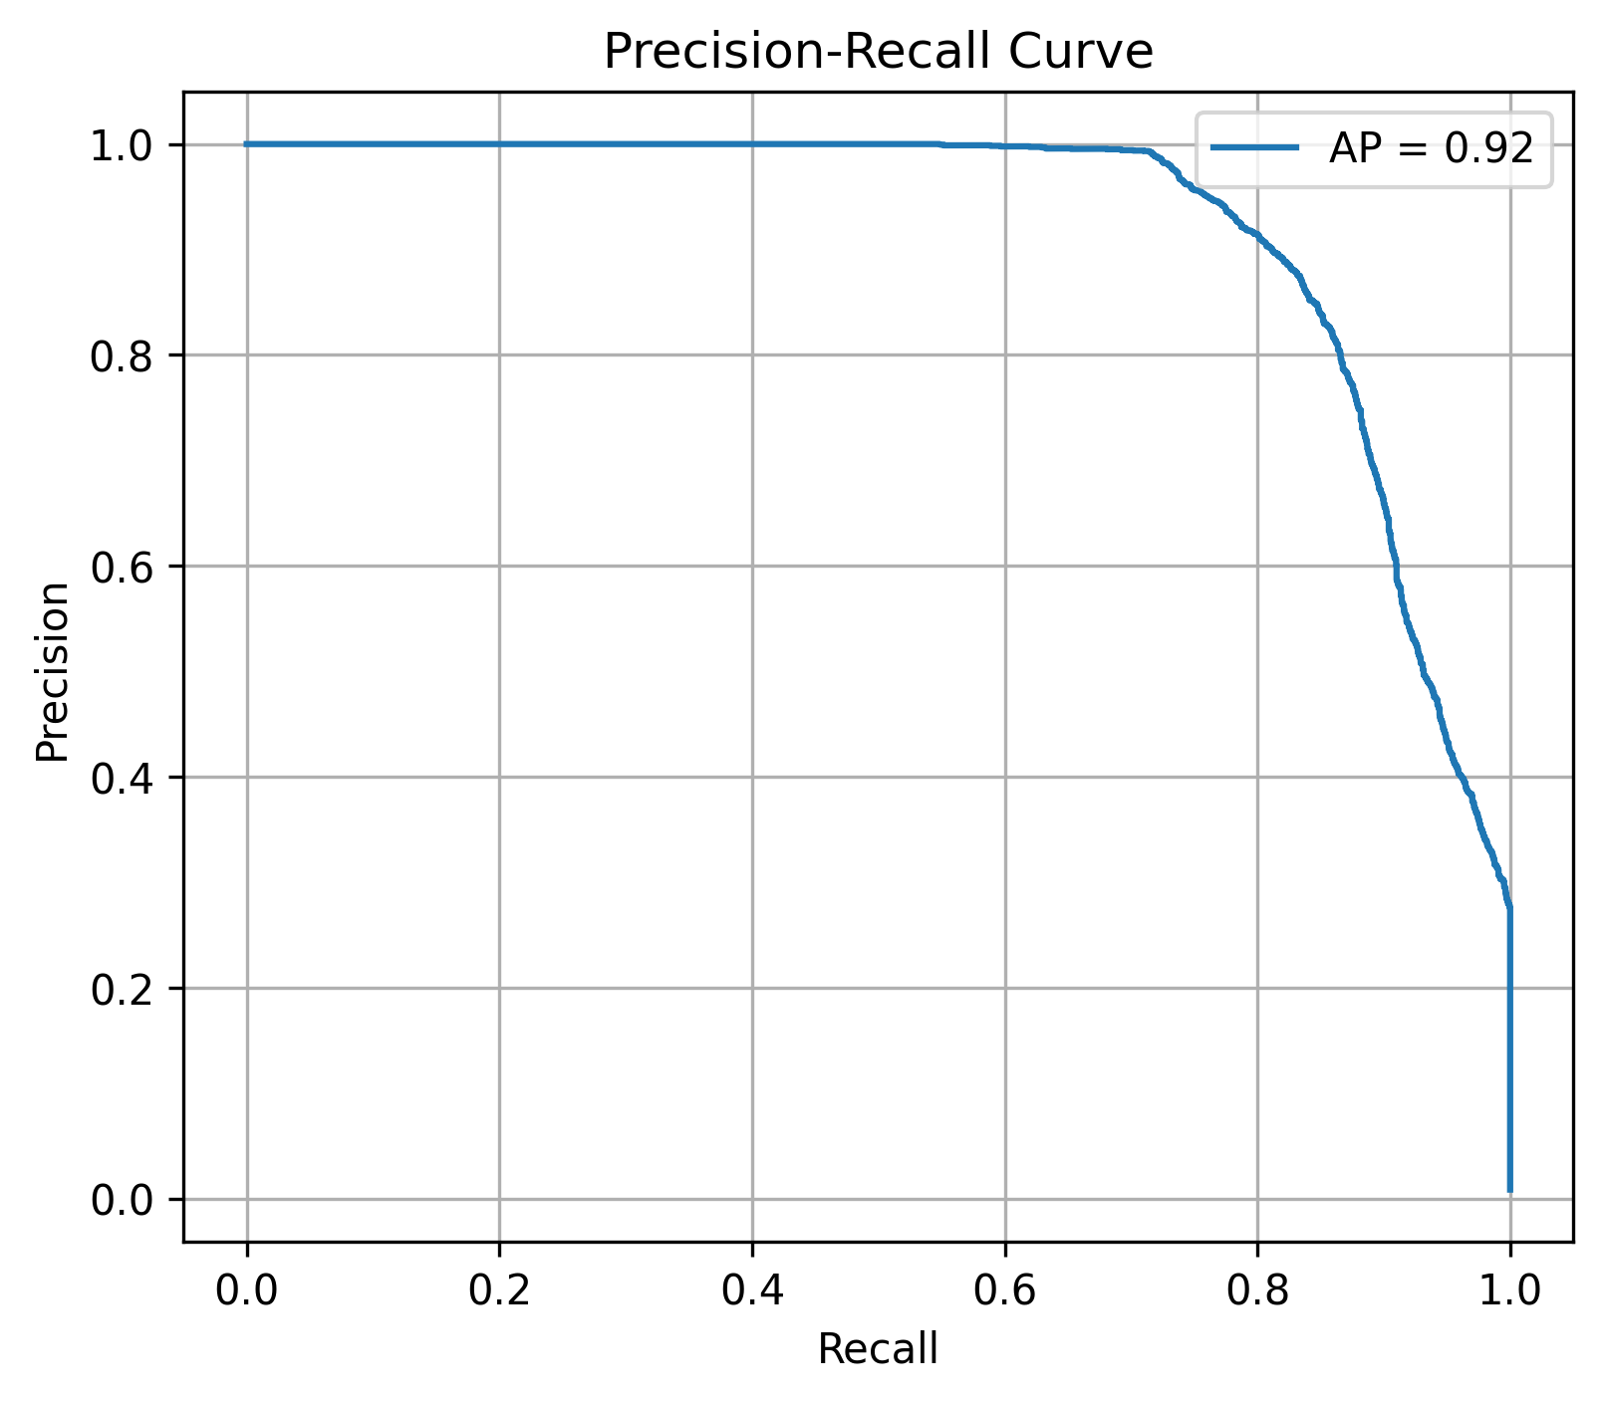
Visual Evaluation
ROC Curve
Precision-Recall Curve (Optional)

Slide 12
ROC Curve
Precision-Recall Curve
Description: Plots True Positive Rate (Recall) vs. False Positive Rate at various thresholds.
Insight: AUC score of 0.997 reflects very high discrimination ability of the model in separating fraud vs non-fraud.
Use: Good for balanced datasets; useful to understand how the model performs across thresholds.
Description: Shows the trade-off between precision (positive predictive value) and recall (sensitivity).
Insight: A high area under the curve (AP = 0.92) indicates excellent performance on imbalanced fraud data, where catching true frauds is more important than overall accuracy.
Use: Preferred metric when dealing with rare events like fraud detection.

Slide 13
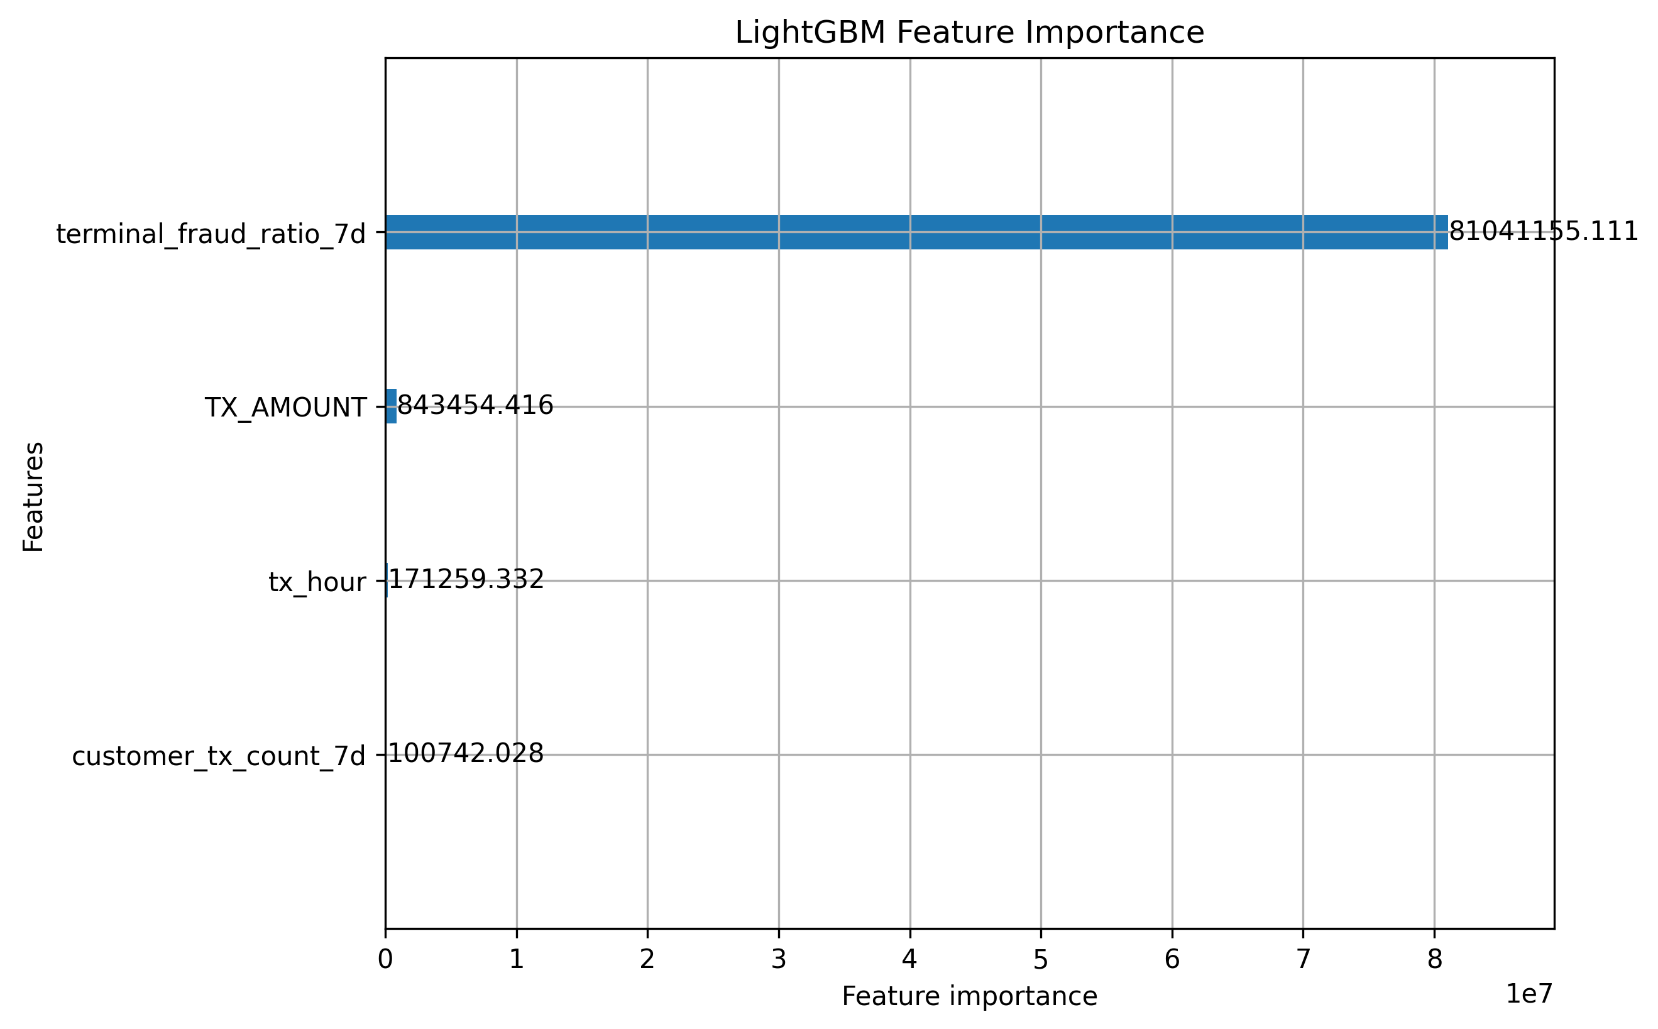
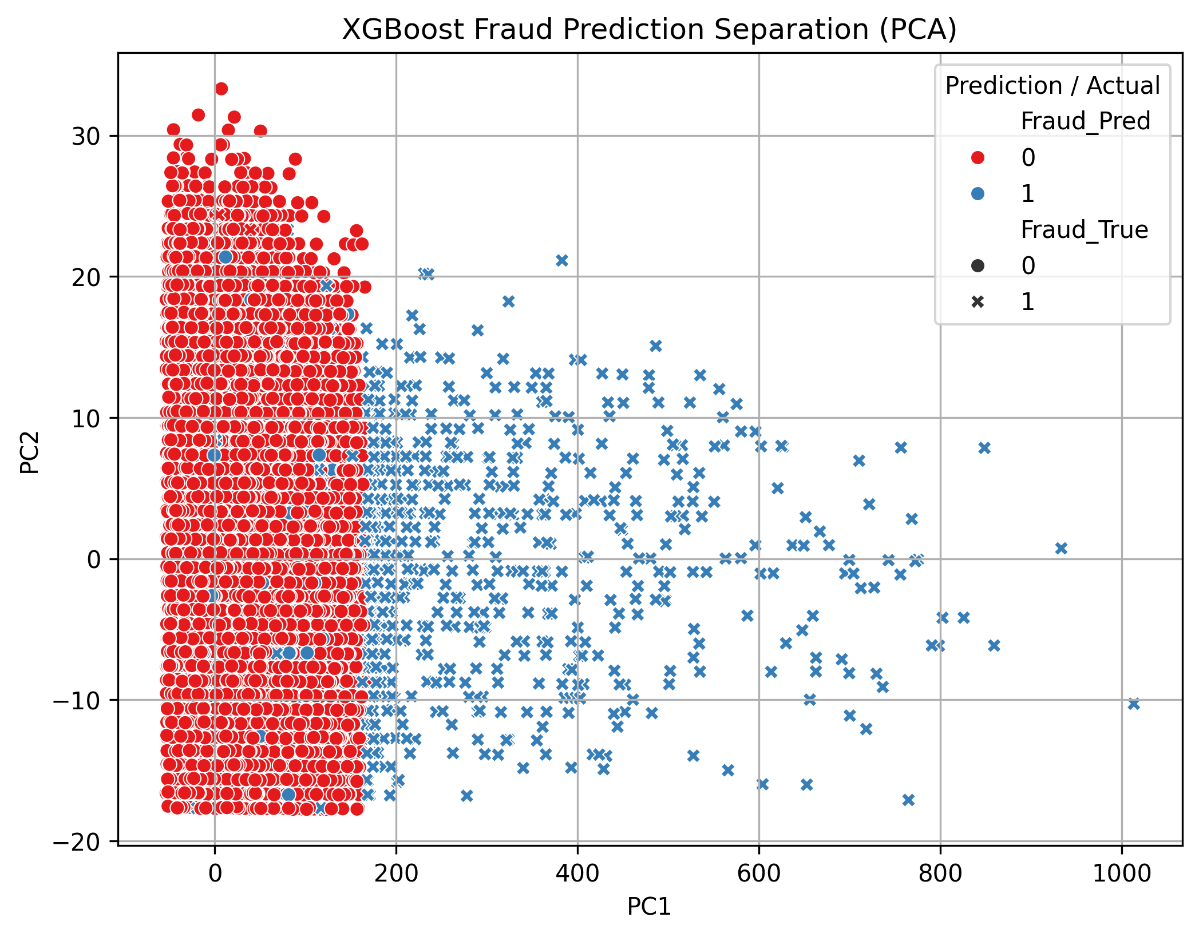
XGBoost Fraud Prediction Separation (PCA) :PCA is used to reduce data to 2D for visualization. It plots predicted vs. actual fraud classes.
Insight: Clear separation between fraudulent and legitimate transactions shows that the model is learning meaningful fraud patterns.
Use: Excellent tool for visually verifying classification quality and spotting overlapping cases.
Feature importance: This plot ranks features based on their importance in predicting fraud.
Insight: terminal_fraud_ratio_7d is the most influential feature, indicating that recent fraud history at a terminal is a strong predictor.
Use: Helps understand which features drive model decisions the most and supports explainability.

Slide 14
Challenges & Improvements
Challenges:
Imbalanced data
Low fraud precision
Improvements:
Threshold tuning
Add more contextual features
Post-processing rules

Slide 15
Conclusion
LightGBM achieved excellent AUC and recall
Ready for deployment with threshold optimization
Useful for flagging suspicious transactions early

